Slide 1
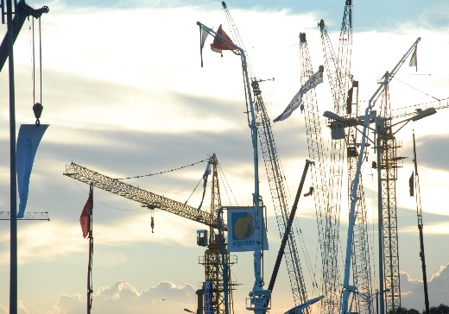
WELCOME

Slide 2
CONTENTS
ECONOMIC INDICATORS TOWARDS GROWTH
INDIA’S INFRASTRUCTURE – AN OVERVIEW
EXCON 2015

Slide 3

ECONOMIC INDICATORS TOWARDS GROWTH

Slide 4
INDIAN ECONOMY – GROWTH INDICATORS
GDP growth of 7.3% this calendar year
Manufacturing PMI in India increased to 51.30 in June 2015
Industrial Production at 4.10 % in April 2015
Forex reserves at $355 billion as FIIs pour dollars in markets
Inflation rate contained at 5.01 percent
Notes:
GDP growth of 7.3% this calendar year
Improving significantly, however, the manufacturing sector grew by 7.1 per cent against the 2013-14 growth of 5.3 per cent. “The encouraging part is the growth in manufacturing, which would also mean that we are also creating jobs in our growth path
http://www.thehindu.com/business/Economy/indias-gdp-at-73-per-cent/article7260536.ece
Manufacturing PMI in India increased to 51.30 in June 2015
Manufacturing PMI in India decreased to 51.30 in June of 2015 from 52.60 in May of 2015. Manufacturing PMI in India averaged 52.09 from 2012 until 2015, reaching an all time high of 55 in June of 2012 and a record low of 48.50 in August of 2013.
http://www.tradingeconomics.com/india/manufacturing-pmi
Industrial Production in India increased 4.10 percent in April of 2015 over the same month in the previous year
Industrial Production in India increased 4.10 percent in April of 2015 over the same month in the previous year. Industrial Production in India averaged 6.52 percent from 1994 until 2015, reaching an all time high of 20 percent in November of 2006 and a record low of -7.20 percent in February of 2009.
http://www.tradingeconomics.com/india/industrial-production
Forex reserves at $355 billion as FIIs pour dollars in markets
Foreign exchange reserves dipped by a marginal $237.5 million to $355.221 billion in the week to June 26 on account of slight decline in a key component, data from the Reserve Bank of India (RBI) showed.
http://profit.ndtv.com/news/forex/article-forex-reserves-down-237-million-at-355-billion-rbi-778101
Inflation rate contained at 5.01 percent
The inflation rate in India was recorded at 5.01 percent in May of 2015. Inflation Rate in India averaged 8.51 percent from 2012 until 2015, reaching an all time high of 11.16 percent in November of 2013 and a record low of 4.38 percent in November of 2014
http://www.tradingeconomics.com/india/inflation-cpi

Slide 5
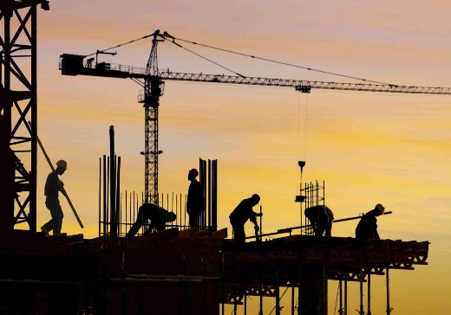
INDIA’S INFRASTRUCTURE

Slide 6
INDIA’S INFRASTRUCTURE
Significant interest from international investors in the infrastructure space.
Government to invest US$ 137 billion in rail network
India to increase investment to US$ 16.15 billion.
Reserve Bank of India (RBI) has notified 100% FDI in the construction sector.
Source : IBEF
Notes:
1. Significant interest from international investors in the infrastructure space.
India is witnessing significant interest from international investors in the infrastructure space. Many international companies are keen on collaborating with India on infrastructure, high speed trains, renewable energy and developing smart cities.
2. Government to invest US$ 137 billion in rail network
The government has unveiled plans to invest US$ 137 billion in its decrepit rail network over the next five years.
3. India to increase investment to US$ 16.15 billion
Over the next year, India will increase investment by about a half to US$ 16.15 billion including funds raised by market borrowing.
4. Reserve Bank of India (RBI) has notified 100% FDI in the construction sector.
The Reserve Bank of India (RBI) has notified 100 per cent foreign direct investment (FDI) under automatic route in the construction development sector.

Slide 7
INDIA’S INFRASTRUCTURE
India's Infrastructure Output Posts Fastest Growth in 6 Months
NHIDCL to award Rs 1.3 trillion highway projects in tough terrain
Sharp pickup in road construction leads to 93% surge in bitumen imports in 2014-15
Indirect tax revenue, which grew to 39.2% in April-May helps to front load expenditure
Notes:
India's Infrastructure Output Posts Fastest Growth in 6 Months
India's infrastructure output expanded for the first time in three months in May, posting an annual growth of 4.4 per cent, which was also its fastest in six months. The infrastructure sector accounts for nearly 38 per cent of India's industrial output.
http://profit.ndtv.com/news/economy/article-indias-infrastructure-output-posts-fastest-growth-in-6-months-776811
NHIDCL to award Rs 1.3-trillion highway projects in tough terrain
The National Highways and Infrastructure Development Corporation (NHIDCL) will also be laying out 1,500 km of highways in various states. NHIDCL has set a target to award projects worth USD 20,475 Million, including 10,000 km of highways and 2,000 bridges
http://economictimes.indiatimes.com/news/economy/infrastructure/nhidcl-to-award-rs-1-3-trillion-highway-projects-in-tough-terrain/articleshow/47662643.cms
Sharp pickup in road construction leads to 93% surge in bitumen imports in 2014-15
A sharp pickup in road construction led to a 93% surge in bitumen imports in 2014-15, when 13 km of roads were built every day on average
http://economictimes.indiatimes.com/news/economy/foreign-trade/sharp-pickup-in-road-construction-leads-to-93-surge-in-bitumen-imports-in-2014-15/articleshow/47712786.cms
A pickup in indirect tax revenue, which grew 39.2% in April-May, has provided elbow room that the ministry is keen to use. "We have asked ministries to front load expenditure
A pickup in indirect tax revenue, which grew 39.2 per cent in April-May, has provided elbow room that the ministry is keen to use. The key areas are roads and shipping along with rural development and agriculture.
http://economictimes.indiatimes.com/news/economy/finance/higher-tax-mop-up-makes-finanace-ministry-seek-spending-hike-to-use-it-for-roads-shipping-agricultural/articleshow/47669868.cms

Slide 8
INDIA’S INFRASTRUCTURE
In 2014-15, 2400 KM of Highway Construction has been awarded through the EPC (Engineering, Procurement and Construction) route.
Enhanced investment in infrastructure by US$ 11.3 billion in this fiscal year
2 % growth in GDP through infrastructure sector – Target
30 km of roads a day as against present 12 km a day.
Notes:
In 2014-15, 2400 KM of Highway Construction has been awarded through the EPC (Engineering, Procurement and Construction) route.
The Centre is forced to roll out more projects through the engineering, procurement and construction (EPC) route. In 2014-15, only 700 km of highways were awarded under PPP mode as against 2,400 km under EPC mode, evidence that PPP is taking a backseat. For the current fiscal year, NHAI is planning to roll out as many as 31 EPC projects as against 10 in PPP. The NHAI may also bid out 17 projects in what is called a hybrid model, a mix of EPC and BOT (a form of PPP) in which the government will support 40 per cent of the cost of a project.
http://economictimes.indiatimes.com/news/economy/infrastructure/what-ails-indias-ppp-model-and-why-it-doesnt-bode-well-for-modi-governments-infrastructure-push/articleshow/47940200.cms
India will increase investment in infrastructure by 700 billion rupees ($11.3 billion) in the fiscal year starting April 1
India will increase investment in India's infrastructure by 700 billion rupees ($11.35 billion) in the fiscal year 2015/16
http://in.reuters.com/article/2015/02/28/india-budget-infra-idINKBN0LW07C20150228
Government is committed to ensure that atleast two percent growth is in GDP through infrastructure sector. The Strategy to achieve a target of building 30 km of roads a day as against present 12 km a day.
In a big push for infrastructure development, the government plans to award Rs 3 lakh crore of road projects this year as it looks to more than double highway construction to 30 km per day.
http://www.dnaindia.com/money/report-government-to-award-road-projects-worth-rs-3-lakh-crore-nitin-gadkari-2087445

Slide 9
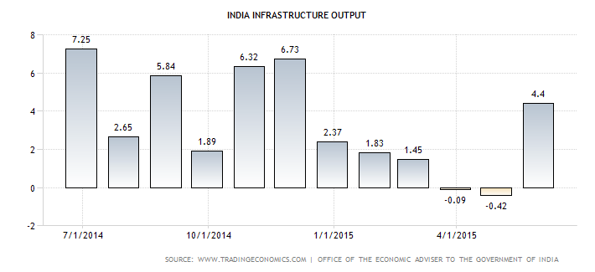
INDIA’S INFRASTRUCTURE
Construction output in India increased 4.40 percent in May of 2015 over the same month in the previous year.

Slide 10

CII’s Service to the Infrastructure & Construction Industry

Slide 11
CONTRIBUTES TO INDIA’S INFRASTRUCTURE DEVELOPMENT
EXCON ENDEAVORS TO ADDRESS
Build India’s infrastructure in an ecologically sustainable manner
    Smart Cities
    Swachh Bharat
    Skill Development
“Make In India” - The National Agenda
Urban renewal
Rural connectivity & Development
Road Building – Accelerating Capacity

Slide 12




Organized by
Sector Partner
Supported by
8th Construction Equipment & Construction Technology Trade Fair
25th – 29th November 2015, BIEC, Bengaluru, India
Notes:
12

Slide 13
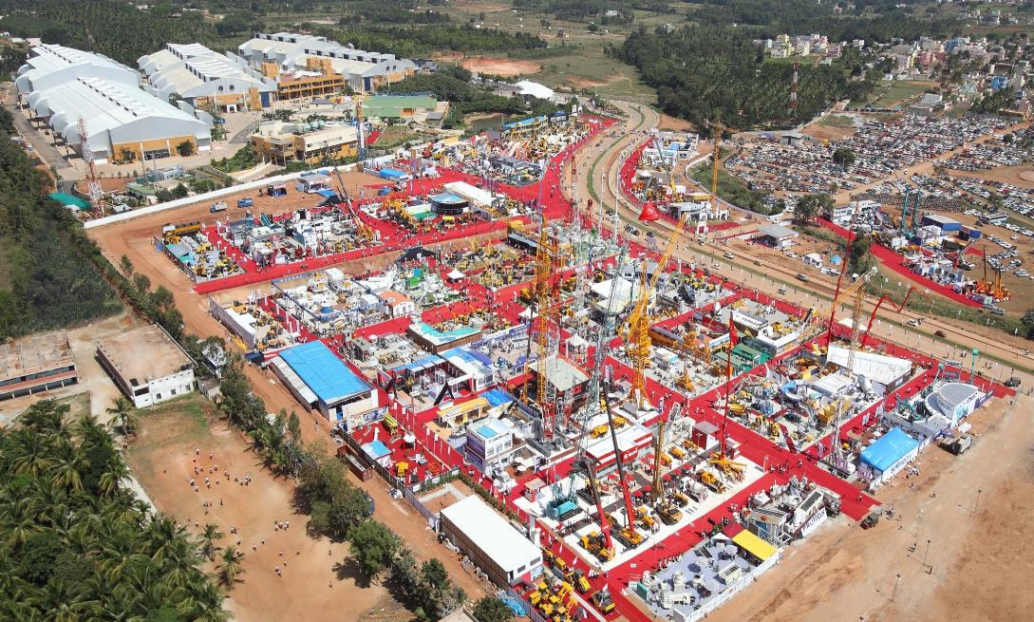






EXCON - AERIAL VIEW

Slide 14





SUPPORTING INTERNATIONAL ASSOCIATIONS
Germany Engineering Federation (VDMA)
China Council for the Promotion of International Trade (CCPIT)
UNACEA
Confindustria Modena from Italy
Korea Construction Equipment Manufactures Association's
Construction Equipment Distributors and Manufacturers Association of Turkey (IMDER)
International Powered Access Federation (IPAF), UK
Notes:
UNACEA and Confindustria Modena are from Italy. UNACEA is a national association for CE and Confindustria is a association for a region in Italy
IPAF is from United Kingdom

Slide 15

The 8th Construction Equipment and Construction Technology Trade Fair
25th – 29th November 2015, BIEC, Bengaluru, India
  The Largest Construction Equipment Exhibition in South Asia
  5 Days of International Exhibition
  850+ Exhibitors, 32000 Business Visitors, 220,000 sq. mtrs of Gross Exhibition Display Area
  Country pavilions from German, Italy, China, Finland, Sweden, South Korea, etc…
  Conferences by ICEMA, BAI and CII

Slide 16
Growth in Exhibitors
2000
2009
2011
2013
2015
Notes:
It started as a humble domestic exhibition in 2000 with 83 exhibitors and grew to be the largest in South Asia
Even during difficult industry situation in 2013, the exhibition was on a growth trajectory . It only demonstrated the industries positive approach and confidence on Brand Excon / CII

Slide 17
Growth in Visitors
expected
Notes:
The numbers have been only growing with each passing edition.
We see more seasoned and senior customers visiting the event
The last edition did see a spurt in international visitors including buying delegations from countries located in SAARC, ASEAN and Africa
We also do international road shows for promoting amongst customers

Slide 18
Growth in Gross Space

Slide 19
Growth in International Exhibitors

Slide 20
Unparalleled Opportunity for International Visitors
Benefit for Companies involved in Construction Equipment & Components manufacturing :
To understand the Indian market for Construction Equipment
To explore joint ventures, technology transfers, etc..
To supply to India
To outsource components supply
To explore opportunities for setting-up their own operations in India

Slide 21
Unparalleled Opportunity for International Visitors
Infrastructure Developers and Construction Companies
To evaluate cost competitiveness
Enable them to handle projects in India / Asia.
Strategize their future plans
Availability of world class equipment, components and spare parts
Notes:
1. To evaluate cost competitiveness
India no longer is a cheap destination. Its competetive cost with excellent skills and R & D
2. Enable them to handle projects in India / Asia.
A number of international companies are handling projects in the region and they could use equipment made locally than importing
3. Strategize future plans
Companies who may have plans to operate in the region in the future also could plan better
4. Availability of World class equipment
MNC’s who have set shop here, large CE companies and more importantly the component industry is exporting products made here to ASEAN, SAARC and Africa

Slide 22
OUR REQUEST
To personally attend Excon 2015
To communicate information on Excon 2015 to the appropriate government departments / Industries / Media, etc.,
To disseminate information on Excon 2015 to sector specific associations in your country
To consider organizing a Business delegation to Excon 2015
To include Excon 2015 in the Embassy / trade office website as the recommended event in India
To Explore organizing an international pavilion in Excon 2017

Slide 23
Any Questions

Slide 24
THANK YOU
&
SEE YOU AT EXCON 2015
Notes:
I thank all of you for being here and before I end, I would leave you with a short film on Excon 2013 which would give you a better understanding of the event.
Thanks again

